Slide 1
Pizzas Sales Analysis

Slide 2


1) Retrieve the total no of orders placed.

Slide 3



Slide 4


3) identify which is the highest priced pizza

Slide 5


4)Identify the most common pizza size ordered

Slide 6
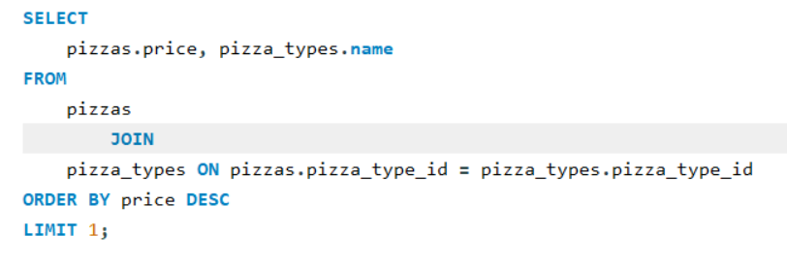

5)Identify the highest price pizza

Slide 7
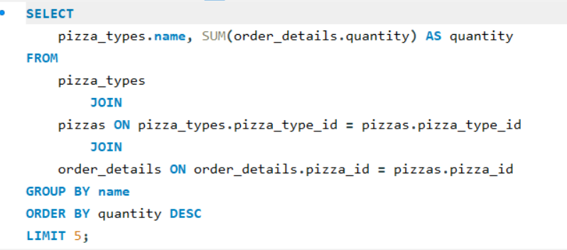

6)List the top 5 pizza types based on their quantity

Slide 8


7)Determine the distribution of orders by hours of the day

Slide 9


8)Join relevant tables to find the category wise distribution of pizzas

Slide 10


9)Group the orders by date and calculate the average no of pizzas ordered per day

Slide 11



Slide 12
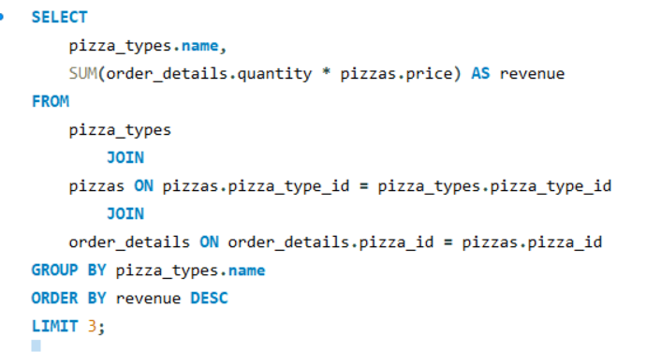

10)Determine the top 3 most ordered pizza types based on revenue

Slide 13
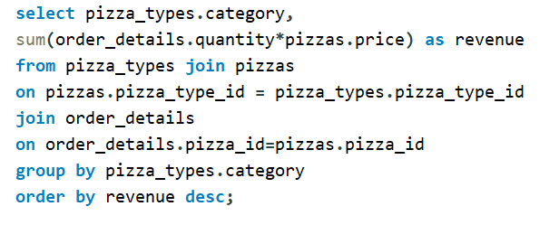

11)Calculate the percentage contribution of each pizza type to total revenue

Slide 14
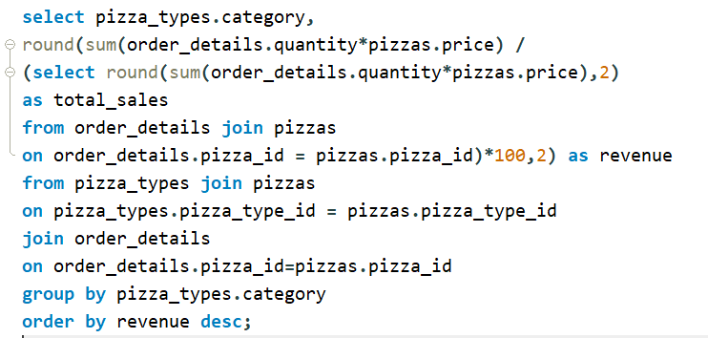

12)Calculate the percentage share of each pizza category

Slide 15
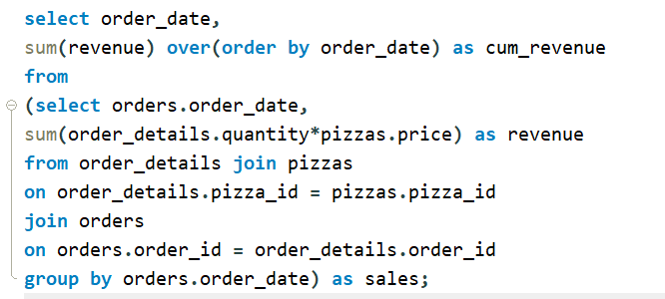

13) Analyze the cumulative revenue generated over time

